Slide 1
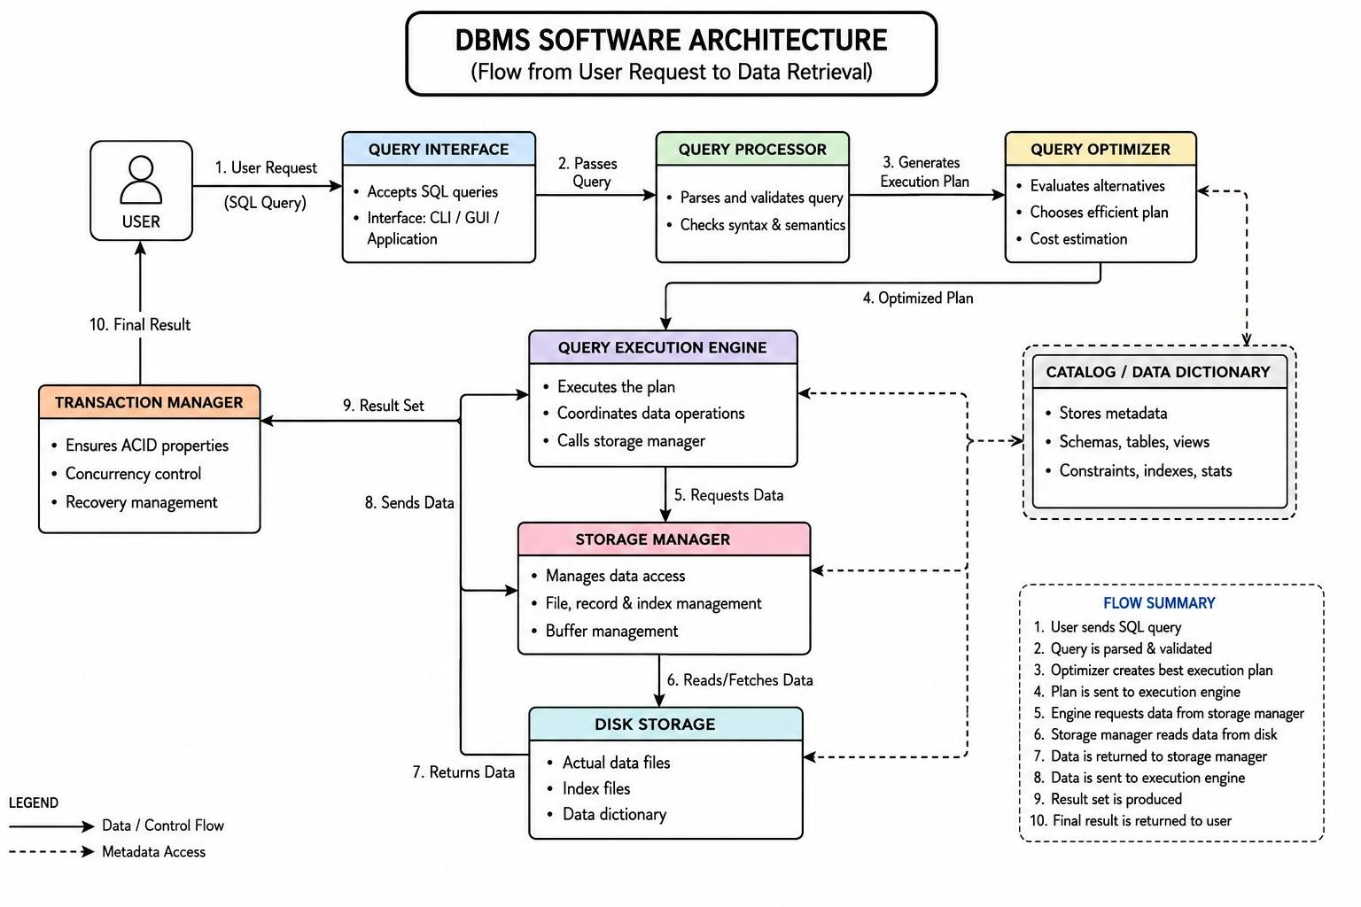
Concept map question - 7
Create a visual concept map for the DBMS software architecture, illustrating the flow from user request to data retrieval.

